Slide 1
Lecture 3: Convolution
Tom Jhou
2021

Slide 2

One note about Jupyter:
I recommend saving copy that you can edit without messing up original:
Notes:
This works like a charm. Before filtering, the background noise ranges over several millivolts, while spikes are only about 300 microvolts.
After filtering, background noise is about 100 microvolts, while spikes are still about 300 microvolts.
We removed a lot of stuff, and drastically reduced the background noise while spikes are almost the same height as before.

Slide 3

Menu/keyboard to add/remove cells:
Keyboard shortcut.
Must hit “ESC” first.
Notes:
This works like a charm. Before filtering, the background noise ranges over several millivolts, while spikes are only about 300 microvolts.
After filtering, background noise is about 100 microvolts, while spikes are still about 300 microvolts.
We removed a lot of stuff, and drastically reduced the background noise while spikes are almost the same height as before.

Slide 4
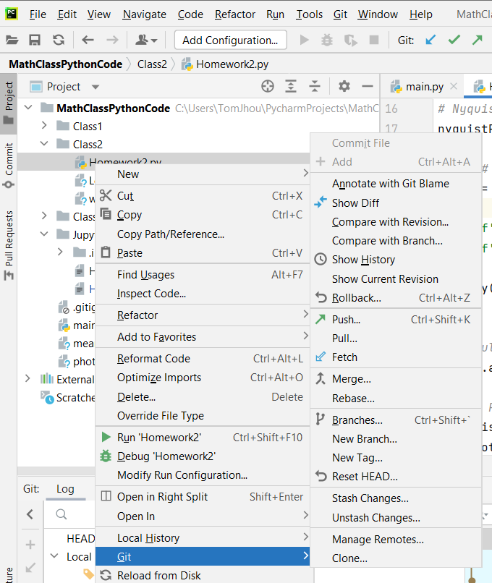
Advanced pro tip: if you accidentally mess up a file, use Git to “rollback”:
Right click
Rolls back to last downloaded version
Notes:
This works like a charm. Before filtering, the background noise ranges over several millivolts, while spikes are only about 300 microvolts.
After filtering, background noise is about 100 microvolts, while spikes are still about 300 microvolts.
We removed a lot of stuff, and drastically reduced the background noise while spikes are almost the same height as before.

Slide 5
A notes about that weird *2/sampleRate thing in “firwin”:
kernel = scipy.signal.firwin(n, cutoff_frequency*2/sampleRate, pass_zero=False)
output = np.convolve(input_signal, kernel);
Notes:
This works like a charm. Before filtering, the background noise ranges over several millivolts, while spikes are only about 300 microvolts.
After filtering, background noise is about 100 microvolts, while spikes are still about 300 microvolts.
We removed a lot of stuff, and drastically reduced the background noise while spikes are almost the same height as before.

Slide 6
Remember the Nyquist frequency
kernel = scipy.signal.firwin(n, cutoff_frequency * 2 / sampleRate, pass_zero=False)
“Nyquist” frequency = half sample rate
The max unambiguously measurable frequency
Notes:
This works like a charm. Before filtering, the background noise ranges over several millivolts, while spikes are only about 300 microvolts.
After filtering, background noise is about 100 microvolts, while spikes are still about 300 microvolts.
We removed a lot of stuff, and drastically reduced the background noise while spikes are almost the same height as before.

Slide 7
Rewrite for readability:
kernel = scipy.signal.firwin(n, cutoff_frequency * 2 / sampleRate, pass_zero=False)
nyquist = sampleRate / 2
kernel = scipy.signal.firwin(n, cutoff_frequency / nyquist, pass_zero=False)
Notes:
This works like a charm. Before filtering, the background noise ranges over several millivolts, while spikes are only about 300 microvolts.
After filtering, background noise is about 100 microvolts, while spikes are still about 300 microvolts.
We removed a lot of stuff, and drastically reduced the background noise while spikes are almost the same height as before.

Slide 8
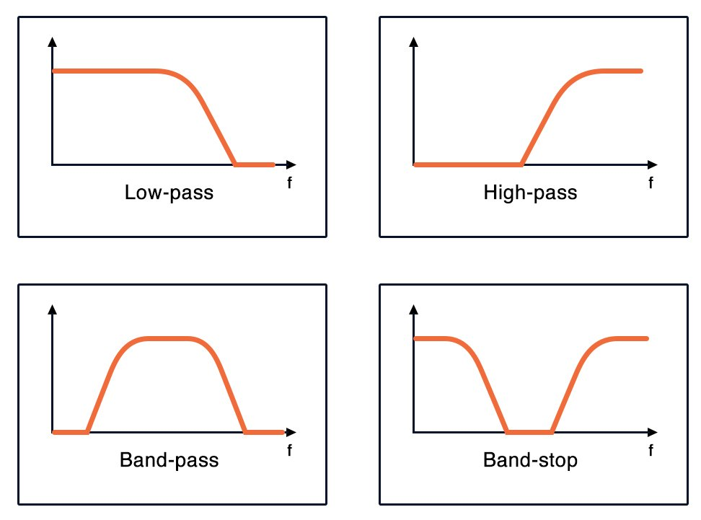
firwin can take multiple frequencies:
kernel = scipy.signal.firwin(n, [f1 / nyquist, f2 / nyquist], pass_zero=False)
Each frequency defines boundary between stop and pass band. Can have as many as you want.
stop
pass
stop
f1
f2
Notes:
This works like a charm. Before filtering, the background noise ranges over several millivolts, while spikes are only about 300 microvolts.
After filtering, background noise is about 100 microvolts, while spikes are still about 300 microvolts.
We removed a lot of stuff, and drastically reduced the background noise while spikes are almost the same height as before.

Slide 9
Switch between band pass vs band stop
kernel = scipy.signal.firwin(n, [f1 / nyquist, f2 / nyquist], pass_zero=False)
pass_zero=False
pass_zero=True
f1
f2
f1
f2
Notes:
This works like a charm. Before filtering, the background noise ranges over several millivolts, while spikes are only about 300 microvolts.
After filtering, background noise is about 100 microvolts, while spikes are still about 300 microvolts.
We removed a lot of stuff, and drastically reduced the background noise while spikes are almost the same height as before.

Slide 10
Let’s (try) to demystify the magic boxes
kernel = scipy.signal.firwin(n, cutoff_frequency*2/sampleRate, pass_zero=False)
output = np.convolve(input_signal, kernel);
Notes:
This works like a charm. Before filtering, the background noise ranges over several millivolts, while spikes are only about 300 microvolts.
After filtering, background noise is about 100 microvolts, while spikes are still about 300 microvolts.
We removed a lot of stuff, and drastically reduced the background noise while spikes are almost the same height as before.

Slide 11
np.convolve()takes two input vectors and produces a third
kernel = scipy.signal.firwin(n, cutoff_frequency*2/sampleRate, pass_zero=False)
output = np.convolve(input_signal, kernel)
Output vector.
Input vector
Kernel … another vector independent of in/out
The kernel “defines” the filter. If you change filter, you will get a different kernel, and vice versa.
Notes:
Back to our regularly scheduled programming …

Slide 12
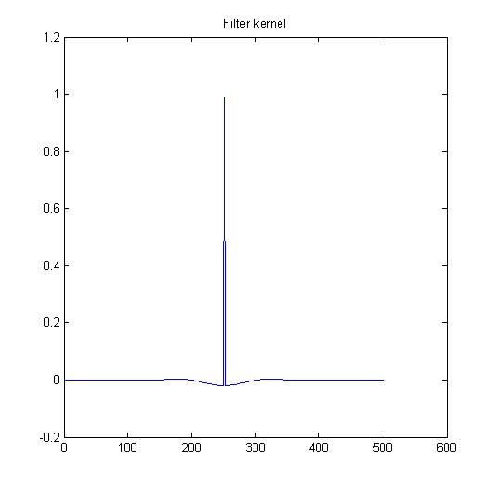
The kernel is just a vector, i.e. list of numbers. Can plot like any other vector, but won’t give you much insight.
High-pass
Low-pass
Band-stop
Notes:
High-order filters often have very “ringy” impulse responses. This will cause waveform distortion. If that is a problem, then it’s best to redesign the experiment to use lower order filters.

Slide 13
The kernel length equals the filter order. Interesting …
Order = 501
Notes:
High-order filters often have very “ringy” impulse responses. This will cause waveform distortion. If that is a problem, then it’s best to redesign the experiment to use lower order filters.

Slide 14
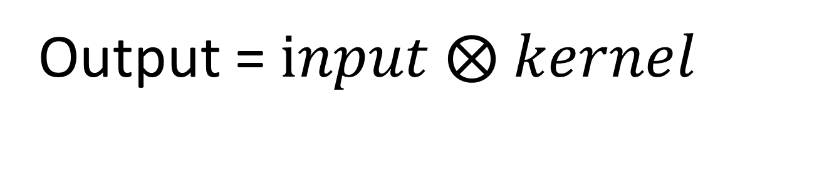
We will use this weird symbol to denote convolution:
Output = $input ⨂ kernel$
Most texts use asterisk * . ⨂ is less common, but avoids confusion with multiplication
Notes:
To understand what a mathematical operation is doing, always, always, always, go to the formula. Even the best verbalized descriptions of math are merely approximations, that will likely miss key aspects of what is being done.

Slide 15
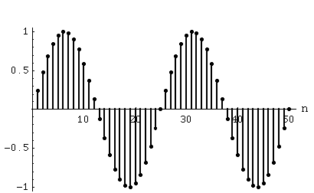
Remember that waves in a computer are samples at regular time intervals:
x[t]
t
Notes:
To understand what a mathematical operation is doing, always start with the formula, then go to geometry.
Verbalized descriptions are almost never adequate, will not be precise enough.
Incidentally, in texts that use asterisk for convolution, then multiplication needs to use a dot, or nothing at all, to avoid confusion.

Slide 16
So waveforms are also “functions”, of sample number t:
x[t]
t
Notes:
To understand what a mathematical operation is doing, always start with the formula, then go to geometry.
Verbalized descriptions are almost never adequate, will not be precise enough.
Incidentally, in texts that use asterisk for convolution, then multiplication needs to use a dot, or nothing at all, to avoid confusion.

Slide 17
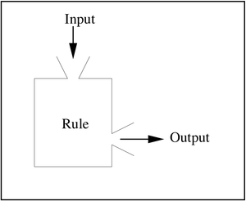
Functions in math, Python, MATLAB, etc are basically this:
Notes:
To understand what a mathematical operation is doing, always start with the formula, then go to geometry.
Verbalized descriptions are almost never adequate, will not be precise enough.
Incidentally, in texts that use asterisk for convolution, then multiplication needs to use a dot, or nothing at all, to avoid confusion.

Slide 18
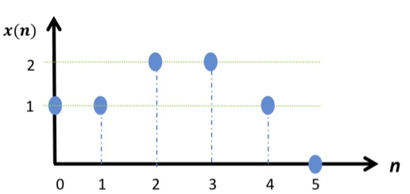
Here is a simpler example:
Notes:
To understand what a mathematical operation is doing, always start with the formula, then go to geometry.
Verbalized descriptions are almost never adequate, will not be precise enough.
Incidentally, in texts that use asterisk for convolution, then multiplication needs to use a dot, or nothing at all, to avoid confusion.

Slide 19
So …
Rule:
if input = 0, then output = 1
if input = 1, then output = 1
If input = 2, then output = 2
If input = 3, then output = 2
If input = 4, then output = 1
If input = 5, then output = 0
x values
y values
Notes:
To understand what a mathematical operation is doing, always start with the formula, then go to geometry.
Verbalized descriptions are almost never adequate, will not be precise enough.
Incidentally, in texts that use asterisk for convolution, then multiplication needs to use a dot, or nothing at all, to avoid confusion.

Slide 20
Of course, we can also represent this “rule” as a vector:
In Python:
x = np.array([1, 1, 2, 2, 1, 0])
Notes:
To understand what a mathematical operation is doing, always start with the formula, then go to geometry.
Verbalized descriptions are almost never adequate, will not be precise enough.
Incidentally, in texts that use asterisk for convolution, then multiplication needs to use a dot, or nothing at all, to avoid confusion.

Slide 21
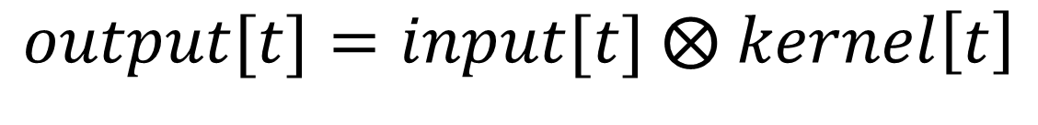
Let’s use “[t]” to turn waveforms into functions:
$$output[t]=input[t] ⨂ kernel\left[t\right]$$
where t = 0, 1, 2, …
Notes:
To understand what a mathematical operation is doing, always start with the formula, then go to geometry.
Verbalized descriptions are almost never adequate, will not be precise enough.
Incidentally, in texts that use asterisk for convolution, then multiplication needs to use a dot, or nothing at all, to avoid confusion.

Slide 22


Let’s abbreviate, or else the screen will soon fill up with long words …
$$input\left[t\right] ⨂ kernel[t]$$
$$(f⨂g) [t]$$
Notes:
To understand what a mathematical operation is doing, always start with the formula, then go to geometry.
Verbalized descriptions are almost never adequate, will not be precise enough.
Incidentally, in texts that use asterisk for convolution, then multiplication needs to use a dot, or nothing at all, to avoid confusion.

Slide 23
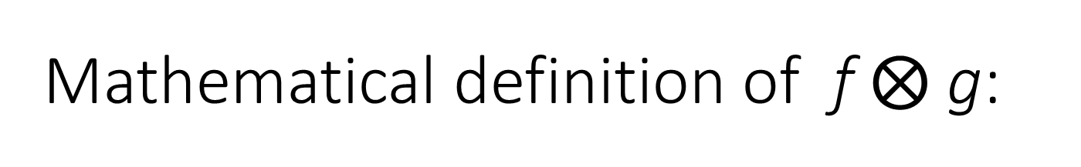
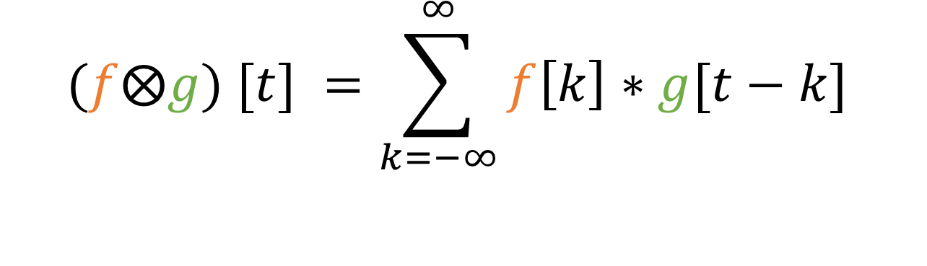
Mathematical definition of f $⨂$g:
$$(f⨂g) [t] =\sum_{k=−∞}^{∞}{f\left[k\right]∗g[t−k}]$$
This is just plain old multiplication.
Notes:
To understand what a mathematical operation is doing, always start with the formula, then go to geometry.
Verbalized descriptions are almost never adequate, will not be precise enough.
Incidentally, in texts that use asterisk for convolution, then multiplication needs to use a dot, or nothing at all, to avoid confusion.

Slide 24
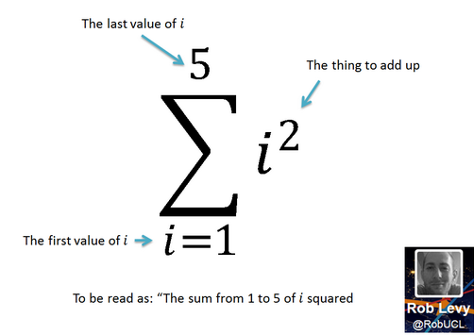
Summation notation:
= 1² + 2² + 3² + 4² + 5²
= 1 + 4 + 9 + 16 + 25
= 55
Notes:
To understand what a mathematical operation is doing, always start with the formula, then go to geometry.
Verbalized descriptions are almost never adequate, will not be precise enough.
Incidentally, in texts that use asterisk for convolution, then multiplication needs to use a dot, or nothing at all, to avoid confusion.

Slide 25
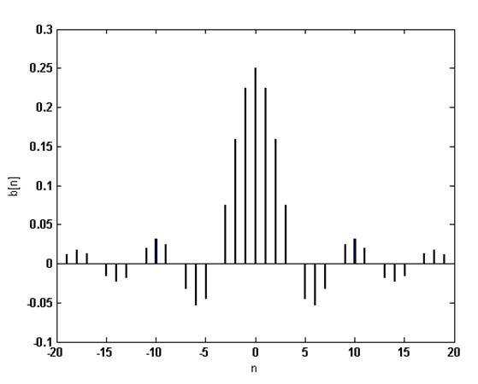
Let’s assume f(t) applies to positive time only:
f(t) = 0 for t < 0, i.e. we have input at positive time only

Slide 26
Let’s assume kernel also applies to positive time only:
g(t) = 0 for t < 0, i.e. kernel has positive time only

Slide 27

Now summation limits are much easier …
$$(f ⨂ g)\left[t\right]= \sum_{k=0 }^{t}{f\left[k\right]g[t−k}]$$
Notes:
To understand what a mathematical operation is doing, always, always, always, go to the formula. Even the best verbalized descriptions of math are merely approximations, that will likely miss key aspects of what is being done.

Slide 28
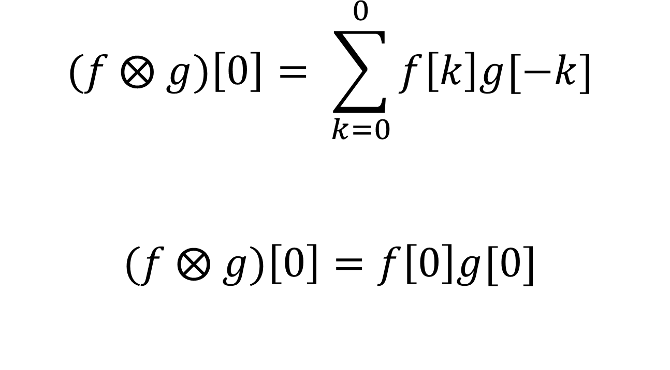
Let’s evaluate output at t = 0:
$$(f ⨂ g)\left[0\right]= \sum_{k=0}^{0}{f\left[k\right]g[−k}]$$
$$(f ⨂ g)\left[0\right]=f\left[0\right]g[0]$$

Slide 29

Let’s evaluate output at t = 1:
$$(f ⨂ g)\left[1\right]= \sum_{k=0}^{1}{f\left[k\right]g[1−k}]$$
$$=f\left[0\right]g\left[1\right]+f\left[1\right]g[0]$$

Slide 30

Let’s evaluate output at t = 2:
$$(f ⨂ g)\left[2\right]= \sum_{k=0}^{2}{f\left[k\right]g[2−k}]$$
$$=f\left[0\right]g\left[2\right]+f\left[1\right]g[1]+f\left[2\right]g[0]$$
Every index
pair sums to 2

Slide 31
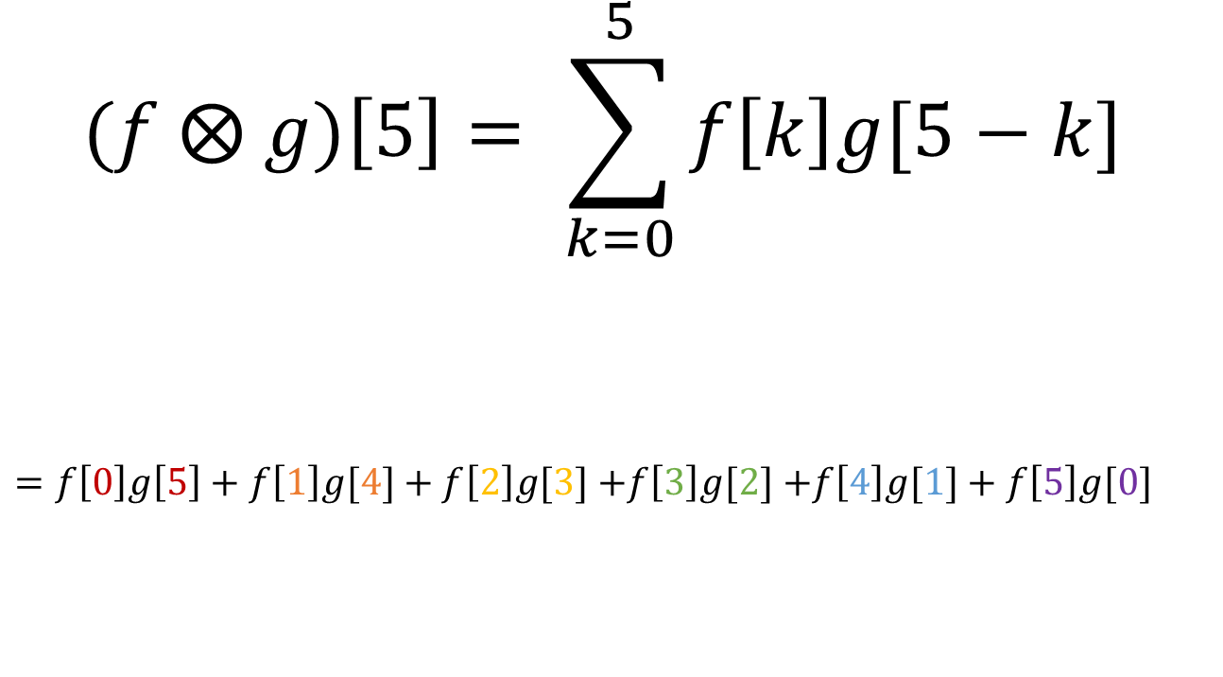
Let’s evaluate output at t = 5:
$$(f ⨂ g)\left[5\right]= \sum_{k=0}^{5}{f\left[k\right]g[5−k}]$$
$=f\left[0\right]g\left[5\right]+f\left[1\right]g[4]+f\left[2\right]g[3]$ $+f\left[3\right]g[2]$ $+f\left[4\right]g[1]+f\left[5\right]g[0]$
Every index
pair sums to 2

Slide 32

Subscripts at right always sum to t:
Subscripts sum to t
k + (t – k) = t
$$(f ⨂ g)\left[t\right]= \sum_{k=−∞}^{∞}{f\left[k\right]g[t−k}]$$
Notes:
To understand what a mathematical operation is doing, always, always, always, go to the formula. Even the best verbalized descriptions of math are merely approximations, that will likely miss key aspects of what is being done.

Slide 33


t = 0
$${ f}_{0},{ f}_{1}, { f}_{2},{ f}_{3}, { f}_{4},{ f}_{5},{ f}_{6}…$$
$$…{ g}_{3}, g_{2},{ g}_{1}, g_{0}$$

Slide 34

t = 1
$${ f}_{0},{ f}_{1}, { f}_{2},{ f}_{3}, { f}_{4},{ f}_{5},{ f}_{6}…$$
$${…g}_{4}, { g}_{3}, g_{2},{ g}_{1}, g_{0}$$

Slide 35

t = 2
$${ f}_{0},{ f}_{1}, { f}_{2},{ f}_{3}, { f}_{4},{ f}_{5},{ f}_{6}…$$
$${…{ g}_{5},g}_{4}, { g}_{3}, g_{2},{ g}_{1}, g_{0}$$

Slide 36

t = 3
$${ f}_{0},{ f}_{1}, { f}_{2},{ f}_{3}, { f}_{4},{ f}_{5},{ f}_{6}…$$
$${…{ g}_{6},{ g}_{5},g}_{4}, { g}_{3}, g_{2},{ g}_{1}, g_{0}$$

Slide 37

t = 4
$${ f}_{0},{ f}_{1}, { f}_{2},{ f}_{3}, { f}_{4},{ f}_{5},{ f}_{6}…$$
$${…{ g}_{6},{ g}_{5},g}_{4}, { g}_{3}, g_{2},{ g}_{1}, g_{0}$$

Slide 38

t = 5
$${ f}_{0},{ f}_{1}, { f}_{2},{ f}_{3}, { f}_{4},{ f}_{5},{ f}_{6}…$$
$${…{ g}_{6},{ g}_{5},g}_{4}, { g}_{3}, g_{2},{ g}_{1}, g_{0}$$

Slide 39

t = 6
$${ f}_{0},{ f}_{1}, { f}_{2},{ f}_{3}, { f}_{4},{ f}_{5},{ f}_{6}…$$
$${…{ g}_{6},{ g}_{5},g}_{4}, { g}_{3}, g_{2},{ g}_{1}, g_{0}$$

Slide 40
Visualization #2: Divide and conquer.
Break f into small pieces.
Convolve each piece with g.
Add results back together.

Slide 41
Break waveform into pieces …
g₄
Waveform g[t] =
[g₀, g₁, g₂, g₃, g₄]
Break into sum of “lollipops”, one for each time value
g₀
g₁
g₂
g₃
Notes:
Any waveform is just a list of values at consecutive points in time (evenly spaced samples).
So we can break a waveform into a set of waveforms, each of which is non-zero at only a single time point.

Slide 42
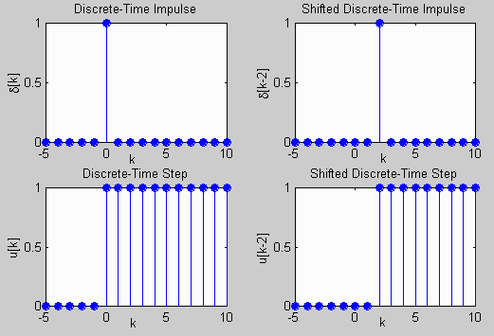
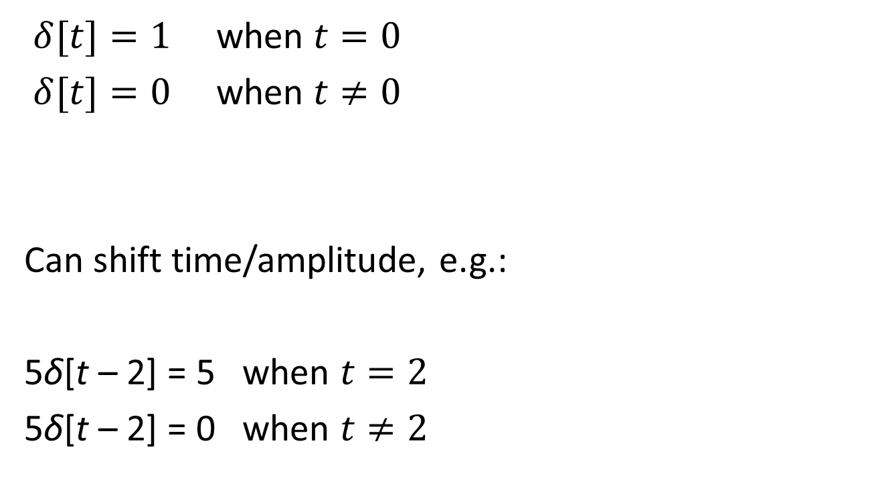
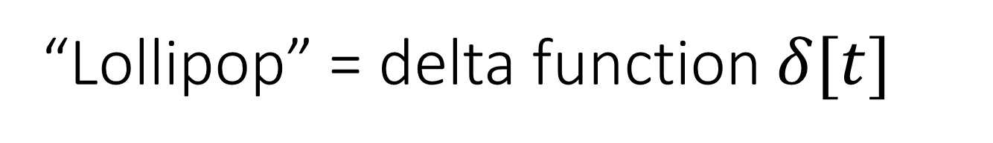
“Lollipop” = delta function $δ[t]$
$δ[t]=1$ when $t=0$
$δ[t]=0$ when $t≠0$
Can shift time/amplitude, e.g.:
5δ[t – 2] = 5 when $t=2$
5δ[t – 2] = 0 when $t≠2$
5
Notes:
Believe it or not, there is a special name for a function consisting of a single value at a single time point. This sounds like a rather boring function. But it’s a very useful building block

Slide 43

f = sum of deltas
f₄
f₀
f₁
f₂
f₃
$⨂$ g[] = ???
f₀δ[t]
f₁δ[t-1]
f₂δ[t-2]
f₃δ[t-3]
f₄δ[t-4]

Slide 44





Divide and conquer …
f₄
f₀
f₁
f₂
f₃
$⨂$ g[] = ???
f₀δ[t]
$⨂$ g[] = ???
f₁δ[t-1]
$⨂$ g[] = ???
f₂δ[t-2]
$⨂$ g[] = ???
f₃δ[t-3]
$⨂$ g[] = ???
f₄δ[t-4]
$⨂$ g[] = ???

Slide 45

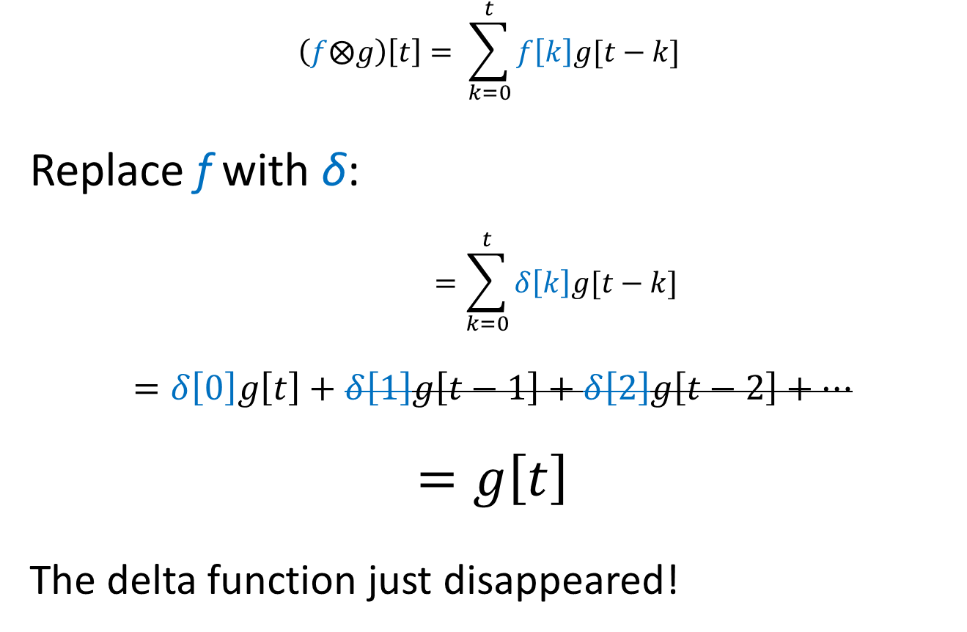
What is $(δ⨂g)[t]$ ?
$$\left(f⨂g\right)\left[t\right]= \sum_{k=0}^{t}{f\left[k\right]g[t−k}]$$
Replace f with δ:
$$=\sum_{k=0}^{t}{δ\left[k\right]g[t−k}]$$
$$=δ\left[0\right]g\left[t\right]+δ\left[1\right]g\left[t−1\right]+δ\left[2\right]g\left[t−2\right]+…$$
$$=g\left[t\right]$$
The delta function just disappeared!
Notes:
Notice that if f is a delta function, then it effectively disappears from the output.
But is convolution just a black hole, that “eats” functions and makes them disappear?
That would not be useful, would it?

Slide 46
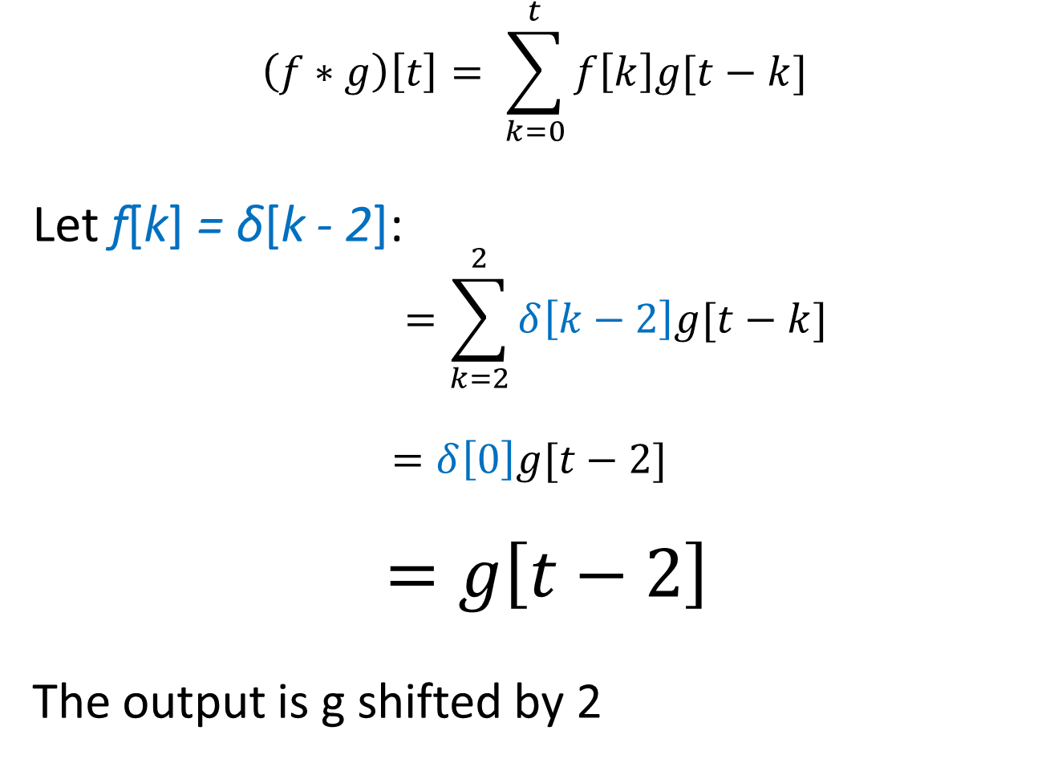
What if delta is shifted in time?
$$\left(f∗g\right)\left[t\right]= \sum_{k=0}^{t}{f\left[k\right]g[t−k}]$$
Let f[k] = δ[k - 2]:
$$=\sum_{k=2}^{2}{δ\left[k−2\right]g[t−k}]$$
$$=δ\left[0\right]g[t−2]$$
$$=g\left[t−2\right]$$
The output is g shifted by 2
@ k = 2, we get:
Notes:
Let f be a scaled, shifted, delta function.
When we write out the equations, we see that the scale factor persists. We still throw away the sum at most values of k, but instead of k=0 being the one we throw away, it is k = 987, because that is where the delta function argument becomes zero.
Hence, convolving a scaled, shifted, delta with g transfers the scale and the shift to g. I.e. g becomes time-shifted and scaled by the same amount as the delta function.
Now this is interesting. Convolution produces an output function that exhibits properties (in time and amplitude) of BOTH inputs!

Slide 47
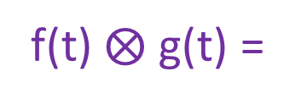
Example1
f(t) =
g(t) =
f(t) $⨂$ g(t) =
Convolve delta with hump,
… get hump
Notes:
Each impulse in the first function gives rise to a scaled, shifted copy of the entire second function, i.e. the “hump”.

Slide 48
Example2
f(t) =
g(t) =
f(t) $⨂$ g(t) =
Convolve shifted delta with hump,
… get shifted hump
Notes:
Each impulse in the first function gives rise to a scaled, shifted copy of the entire second function, i.e. the “hump”.

Slide 49

Example3
f(t) =
g(t) =
f(t) $⨂$ g(t) =
Convolve 2 deltas with hump,
… get two humps, with
Notes:
Each impulse in the first function gives rise to a scaled, shifted copy of the entire second function, i.e. the “hump”.

Slide 50

Example
g(t) =
f(t) =
Convolve 3 spikes with hump
f(t) $⨂$ g(t) =
Notes:
Each impulse in the first function gives rise to a scaled, shifted copy of the entire second function, i.e. the “hump”.

Slide 51
Overlap …
f(t) =
“Constructive interference”
g(t) =

Slide 52
Alternation
f(t) =
“Destructive interference”
Slowly changing inputs are augmented.
Fast changing inputs are shrunk
= low-pass filter.
g(t) =

Slide 53
Example #4
Instead of hump, try this funky shape.
Has positive center spike, and negative “surround”
Notes:
Things look reversed now. The low-frequency input produces destructive interference, instead of constructive like before. The high-frequency input produces constructive interference, instead of destructive as we saw before.
This is a simple “high-pass” filter, whereas the previous example was a simple “low-pass” filter.

Slide 54
Example #4
Slowly changing inputs tend to shrink.
Notes:
Things look reversed now. The low-frequency input produces destructive interference, instead of constructive like before. The high-frequency input produces constructive interference, instead of destructive as we saw before.
This is a simple “high-pass” filter, whereas the previous example was a simple “low-pass” filter.

Slide 55
Example #4
Rapidly changing inputs are augmented.
= high-pass filter.
Notes:
Things look reversed now. The low-frequency input produces destructive interference, instead of constructive like before. The high-frequency input produces constructive interference, instead of destructive as we saw before.
This is a simple “high-pass” filter, whereas the previous example was a simple “low-pass” filter.

Slide 56
The humpey and spikey waves are two “kernals”, which define filter properties
Low-pass kernel
High-pass kernel

Slide 57
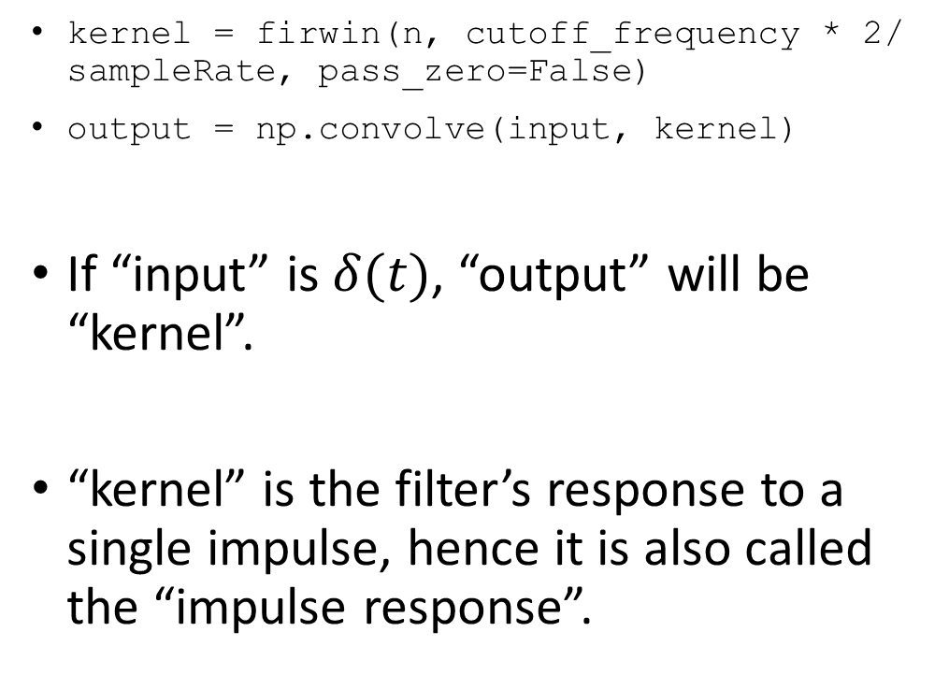
Look at this magic “w” again:
kernel = firwin(n, cutoff_frequency * 2/ sampleRate, pass_zero=False)
output = np.convolve(input, kernel)
If “input” is $δ(t)$, “output” will be “kernel”.
“kernel” is the filter’s response to a single impulse, hence it is also called the “impulse response”.

Slide 58
The end (ignore all slides after this)

Slide 59
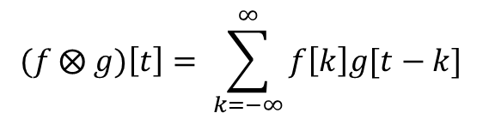
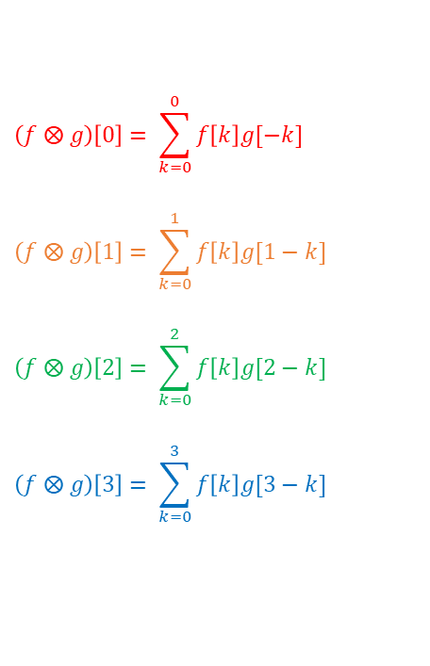
How to visualize this?
Draw pairwise products on a grid …
$$(f ⨂ g)\left[t\right]= \sum_{k=−∞}^{∞}{f\left[k\right]g[t−k}]$$
 | g[0] | g[1] | g[2] | g[3]
f[0] | f[0]*g[0] | f[0]*g[1] | f[0]*g[2] | f[0]*g[3]
f[1] | f[1]*g[0] | f[1]*g[1] | f[1]*g[2] | f[1]*g[3]
f[2] | f[2]*g[0] | f[2]*g[1] | f[2]*g[2] | f[2]*g[3]
f[3] | f[3]*g[0] | f[3]*g[1] | f[3]*g[2] | f[3]*g[3]
$$\left(f ⨂ g\right)\left[0\right]= \sum_{k=0}^{0}{f\left[k\right]g[−k}]$$
$$\left(f ⨂ g\right)\left[1\right]= \sum_{k=0}^{1}{f\left[k\right]g[1−k}]$$
$$\left(f ⨂ g\right)\left[2\right]= \sum_{k=0}^{2}{f\left[k\right]g[2−k}]$$
$$\left(f ⨂ g\right)\left[3\right]= \sum_{k=0}^{3}{f\left[k\right]g[3−k}]$$
t = 0
t = 1
t = 2
t = 3

Slide 60

Convolution is commutative.
Switching f, g flips grid diagonally = same answer
$$(f ⨂ g)\left[t\right]=(g ⨂ f)\left[t\right]$$
Sum of subscripts = 0
Sum of subscripts = 2
Sum of subscripts = 1
 | g[0] | g[1] | g[2] | g[3]
f[0] | f[0]*g[0] | f[0]*g[1] | f[0]*g[2] | f[0]*g[3]
f[1] | f[1]*g[0] | f[1]*g[1] | f[1]*g[2] | f[1]*g[3]
f[2] | f[2]*g[0] | f[2]*g[1] | f[2]*g[2] | f[2]*g[3]
f[3] | f[3]*g[0] | f[3]*g[1] | f[3]*g[2] | f[3]*g[3]
Notes:
Will leave this as an exercise for the reader to prove …

Slide 61
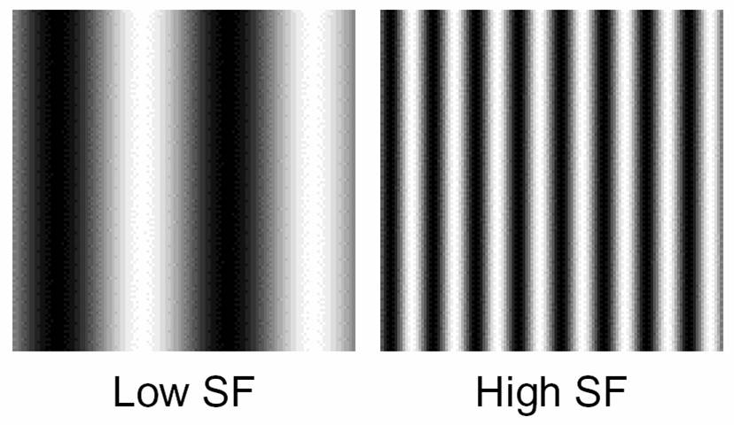
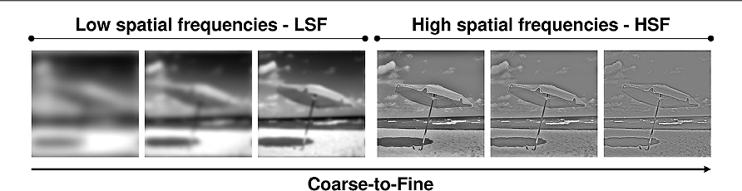
2-D analog: spatial frequencies

Slide 62
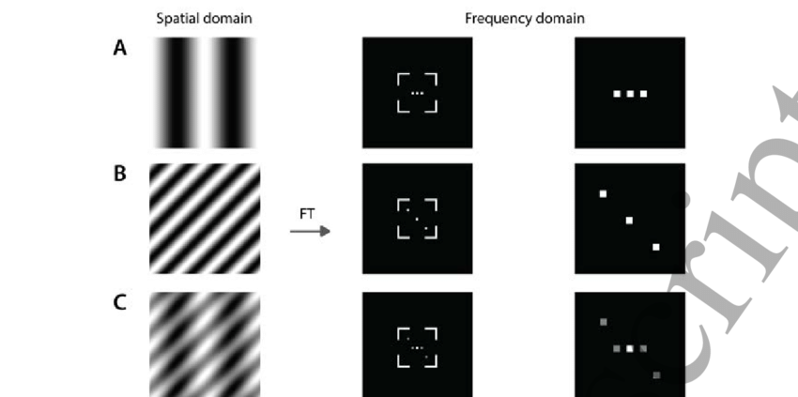
2-D Fourier Transform

Slide 63
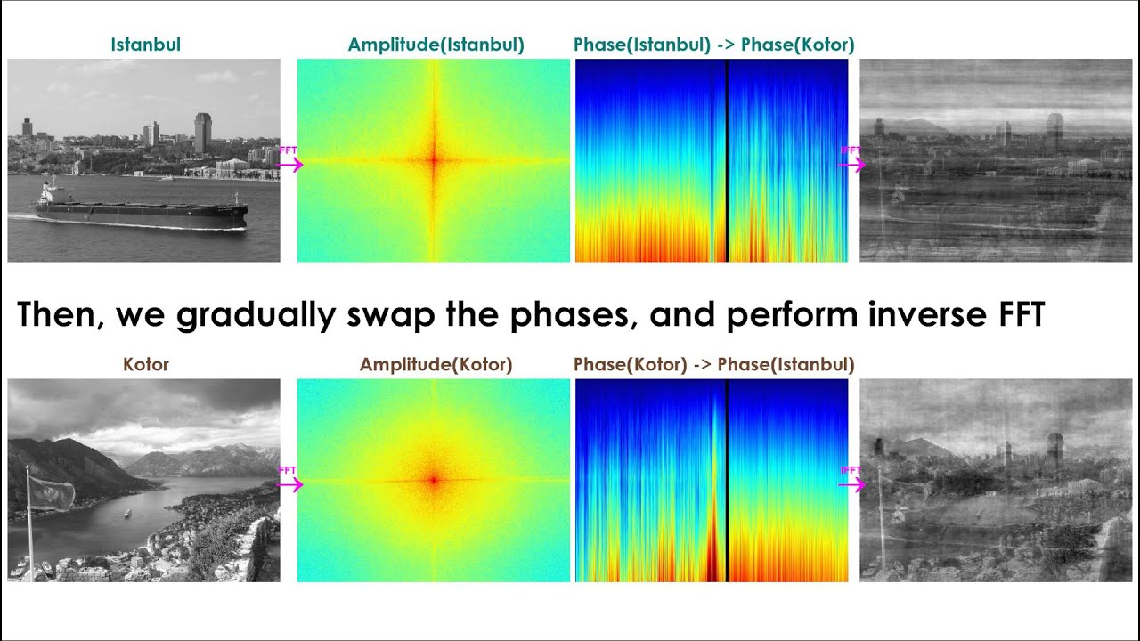
2-D Fourier Transform

Slide 64

2-D convolution (low pass)

Slide 65
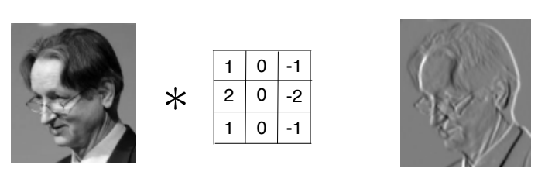
2-D convolution (edge detection)

Slide 66
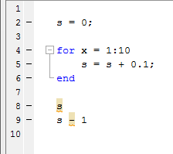

Finally, some notes about digitization

Slide 67
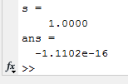
Well, this is unexpected …
Notes:
So … 1 is not 1, and 1 minus 1 is not zero. Whaaaaat?

Slide 68
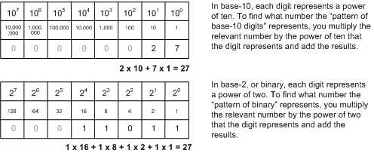
Digital numbers
Notes:
Base two works on powers of 2 instead of powers of 10.

Slide 69
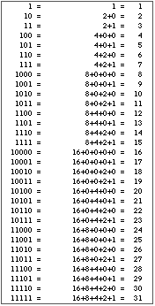
Counting in binary

Slide 70
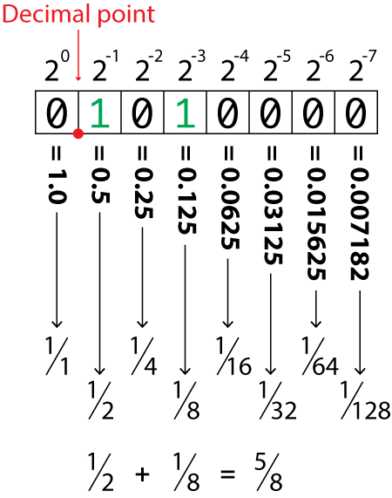
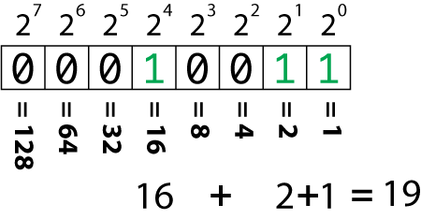
What about fractions?
Notes:
Instead of positive powers of two, we have negative powers.

Slide 71
Example: convert 0.1(decimal) to binary
0.1 (decimal) is 0.00011001100110011 … in binary
An infinite repeating pattern.
0.1 is < 1/2 0
0.1 is < 1/4 0
0.1 is < 1/8 0
0.1 is > 1/16, by 0.0375 1
0.0375 > 1/32 by 0.00625 1
0.00625 < 1/64 0
0.00625 < 1/128 0
0.00625 > 1/256 by 0.00234375 1
0.00234375 > 1/512 by 0.000390625 1
0.000390625 < 1/1024 0
0.000390625 < 1/2048 0
0.000390625 > 1/4096 by 0.000146484375 1
0.000146484375 > 1/8192 by 0.0000244140625 1

Slide 72
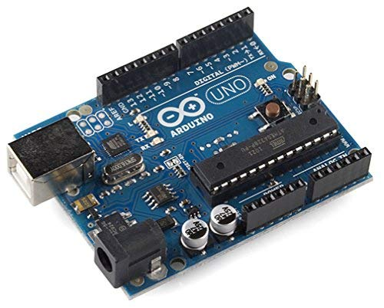
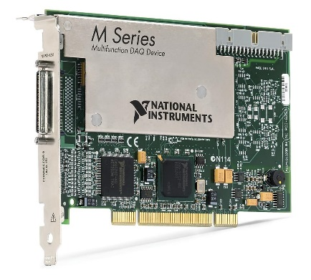
Can’t have infinite bits. How many is practical?
MATLAB uses 64 bit arithmetic. 2^64 = 1.8x10¹⁹
But universe is analog. Have to convert to digital, and that can get expensive.
10-bit A/D converter
9.6kHz sample rate
$15.82 from Amazon
18-bit A/D converter
625kHz sample rate
$2,128.00 from
National Instruments

Slide 73
MATLAB (and many similar programs) use “double precision floating point”
Scientific notation in decimal, e.g. 6.02 x10²³
Scientific notation in binary, e.g. 1.00110011 x 10¹⁰¹
Mantissa (52 bits), exponent (11 bits), sign (1 bit)
Total = 64 bits.
Older programs use 32-bit “single-precision” floating point. Back when memory was expensive, this was the default. Now obsolete.

Slide 74
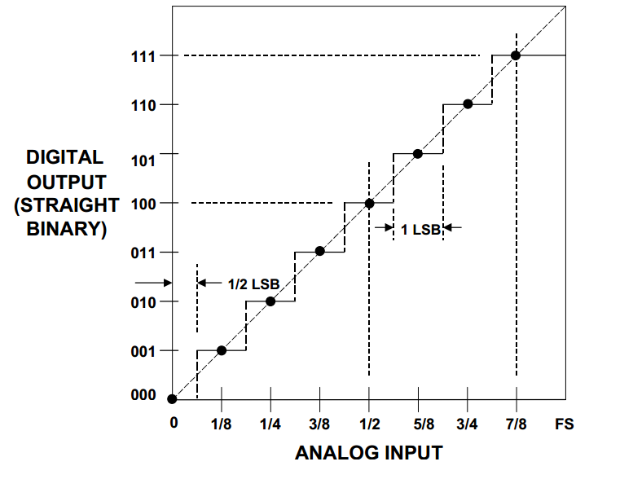
How many bits do we need?
Limiting factor is usually the digitization, when analog signals are first converted to digital.

Slide 75
Tradeoff between precision and cost
More bits give more precision, also more cost
Brain signals: EEG ~20mV, spikes ~5-200µV, movement artifacts ~500mV
Range is about 2^17. So 18 bits gives you both EEG and spikes. If you just want one or the other, can use fewer bits.
10-bit A/D converter
9.6kHz sample rate
$15.82 from Amazon
18-bit A/D converter
625kHz sample rate
$2,128.00 from
National Instruments
Notes:
The limiting factor is not the computation, but the initial digitization

Slide 76
Brain signals are small. Can scale up to match input range of device.
Arduino maps 0 - 5 volt inputs to binary values 0 – 1023 (= 2⁹ – 1).
Each binary increment = 5/1024 = ~5mV
Brain signals: EEG ~±10mV.
Can amplify 250x (with analog amplifier), giving ±2.5V. Then add 2.5V to give 0-5V range. Now each binary increment = 5/1024/250 = ~20µV.
But spike signals can range ~5-200µV. Not enough “dynamic range”, i.e. range between biggest and smallest resolvable signals.
Notes:
The limiting factor is not the computation, but the initial digitization

Slide 77
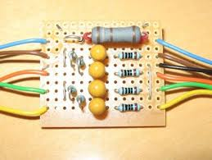
Why not just use analog filters? Until 1980s, this was the norm.
Analog filters
Digital filters
Fast (essentially zero delay).
Can be super cheap. An RC lowpass filter cost < $0.01
But: not flexible. Changing parameters requires soldering or switching different components.
Some designs are nearly impossible to implement (e.g. symmetric impulse function)
Need digitizer (expensive)
Need powerful processor to handle arithmetic (expensive)
But: extremely flexible. Change filter by changing program.
Can implement anything that is mathematically conceivable.

Slide 78
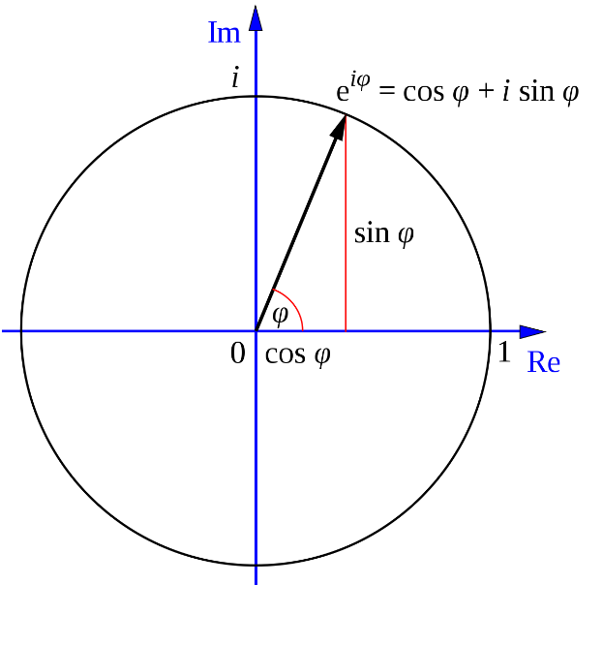
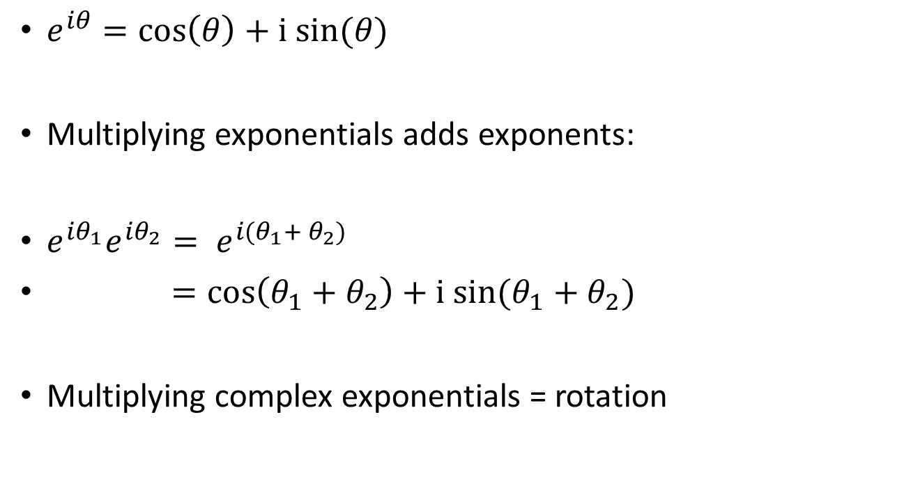
Review of Euler’s formula:
$e^{iθ}=\cos\left(θ\right)+i sin⁡(θ)$
Multiplying exponentials adds exponents:
$e^{iθ_{1}}e^{{iθ}_{2}}{= e}^{i(θ_{1}+ θ_{2})}$
$=\cos\left(θ_{1}+θ_{2}\right)+i sin⁡(θ_{1}+θ_{2})$
Multiplying complex exponentials = rotation
sine
cosine
0
π
2π

Slide 79

Evaluate F(z) for a 100-term input
Define F(z) = f₀ + f₁z + f₂z² + … f₉₉z⁹⁹. Evaluate at $z= e^{2πi/100}$
$z^{k}= {(e^{2πi/100})}^{k}=e^{2πik/100}=\cos\left(\frac{2πk}{100}\right)+i sin⁡(\frac{2πk}{100})$
where k = 0, 1, … 99
z⁰
z¹
z²
z⁹⁹
Imaginary part
F(z) is dot product of f_{n} with a one-cycle sinusoid.
Real part
Notes:
So, we are going around an (almost) full circle in 100 steps. Sweet.

Slide 80

f$⨂$g = g$⨂$f
Order does not matter in the end

Slide 81

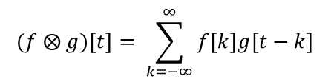
Diagonal sum of products:
Assume f[t] and g[t] = 0 for t < 0
$$(f ⨂ g)\left[t\right]= \sum_{k=−∞}^{∞}{f\left[k\right]g[t−k}]$$
$$\left(f ⨂ g\right)\left[0\right]= \sum_{k=0}^{0}{f\left[k\right]g[−k}]$$
$$\left(f ⨂ g\right)\left[1\right]= \sum_{k=0}^{1}{f\left[k\right]g[1−k}]$$
$$\left(f ⨂ g\right)\left[2\right]= \sum_{k=0}^{2}{f\left[k\right]g[2−k}]$$
$$\left(f ⨂ g\right)\left[3\right]= \sum_{k=0}^{3}{f\left[k\right]g[3−k}]$$
 | g[0] | g[1] | g[2] | g[3]
f[0] | f[0]*g[0] | f[0]*g[1] | f[0]*g[2] | f[0]*g[3]
f[1] | f[1]*g[0] | f[1]*g[1] | f[1]*g[2] | f[1]*g[3]
f[2] | f[2]*g[0] | f[2]*g[1] | f[2]*g[2] | f[2]*g[3]
f[3] | f[3]*g[0] | f[3]*g[1] | f[3]*g[2] | f[3]*g[3]
Notes:
Suppose I make a table with rows and columns, where the rows are labeled with the elements of f, and the columns labeled with the elements of g. Every element of the table is a product of the corresponding row and column labels.
The convolution of f and g is now the some of the products along the diagonals.
This is easy to see from the equation. But it doesn’t give us much insight into what is really going on.

Slide 82
Multiplying F(z)*G(z) convolves coefficients of F and G!
F(z)G(z) = f₀g₀ + (f₀g₁ + f₁g₀)z + (f₀g₂ + f₁g₁ + f₂g₀)z² + …
Coefficients of F(z)*G(z) are diagonal sum of products of the coefficients of F, G, i.e. their convolution!
 | g[0] | g[1] | g[2] | g[3]
f[0] | f[0]*g[0] | f[0]*g[1] | f[0]*g[2] | f[0]*g[3]
f[1] | f[1]*g[0] | f[1]*g[1] | f[1]*g[2] | f[1]*g[3]
f[2] | f[2]*g[0] | f[2]*g[1] | f[2]*g[2] | f[2]*g[3]
f[3] | f[3]*g[0] | f[3]*g[1] | f[3]*g[2] | f[3]*g[3]

Slide 83
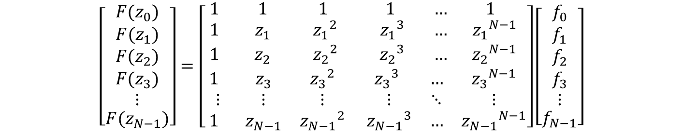
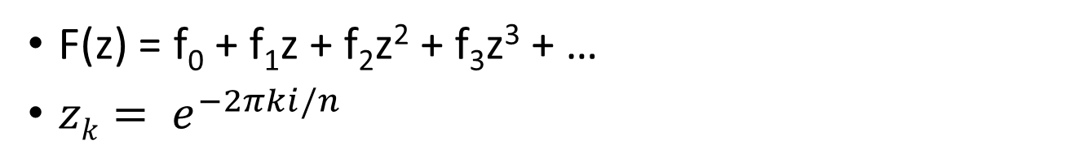
We get a matrix …
$$\left[\begin{matrix}\begin{matrix}{F(z}_{0}) \\ {F(z}_{1})\end{matrix} \\ \begin{matrix}{F(z}_{2}) \\ \begin{matrix}\begin{matrix}{F(z}_{3}) \\ ⋮\end{matrix} \\ {F(z}_{N−1})\end{matrix}\end{matrix}\end{matrix}\right]=\left[\begin{matrix}\begin{matrix} 1 & 1 & 1 \\ 1 & z_{1} & {z_{1}}^{2} \\ 1 & z_{2} & {z_{2}}^{2}\end{matrix} & \begin{matrix} 1 & … & 1 \\ {z_{1}}^{3} & … & {z_{1}}^{N−1} \\ {z_{2}}^{3} & … & {z_{2}}^{N−1}\end{matrix} \\ \begin{matrix}1 & z_{3} & {z_{3}}^{2} \\ ⋮ & ⋮ & ⋮ \\ 1 & z_{N−1} & {z_{N−1}}^{2}\end{matrix} & \begin{matrix}{z_{3}}^{3} & … & {z_{3}}^{N−1} \\ ⋮ & ⋱ & ⋮ \\ {z_{N−1}}^{3} & … & {z_{N−1}}^{N−1}\end{matrix}\end{matrix}\right]\left[\begin{matrix}\begin{matrix}f_{0} \\ f_{1}\end{matrix} \\ \begin{matrix}f_{2} \\ \begin{matrix}\begin{matrix}f_{3} \\ ⋮\end{matrix} \\ f_{N−1}\end{matrix}\end{matrix}\end{matrix}\right]$$
F(z) = f₀ + f₁z + f₂z² + f₃z³ + …
$zk= e^{−2πki/n}$
Notes:
Actually, the F(z) formulation is slightly more flexible, in that we can evaluate it for values of k that are not integers 0 … N-1.

Slide 84
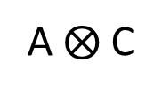
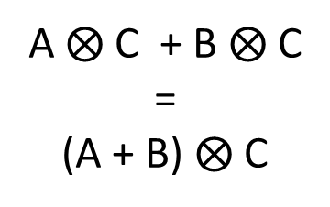

Divide-and-conquer is possible because of linearity …
1. Convolve with C
A
A $⨂$ C
B
B $⨂$ C
2. Then sum
1. Sum first
A $⨂$ C + B $⨂$ C
=
(A + B) $⨂$ C
A + B
2. Then convolve with C
Notes:
Linearity looks like the distributive property you learned for ordinary multiplication, which is a special case of linearity.

Slide 85
Formal definition of linearity
A function f is linear if and only if:
f(x + y) = f(x) + f(y)
af(x) = f(ax)
Notes:
If you want to convolve A with the sum of B and C, you can break it into two easier tasks. First convolve A with B, then A with C, then add the two results.
All linear functions are handy this way, they can always be broken down into parts, solved independently, then added back together.

